Slide 1
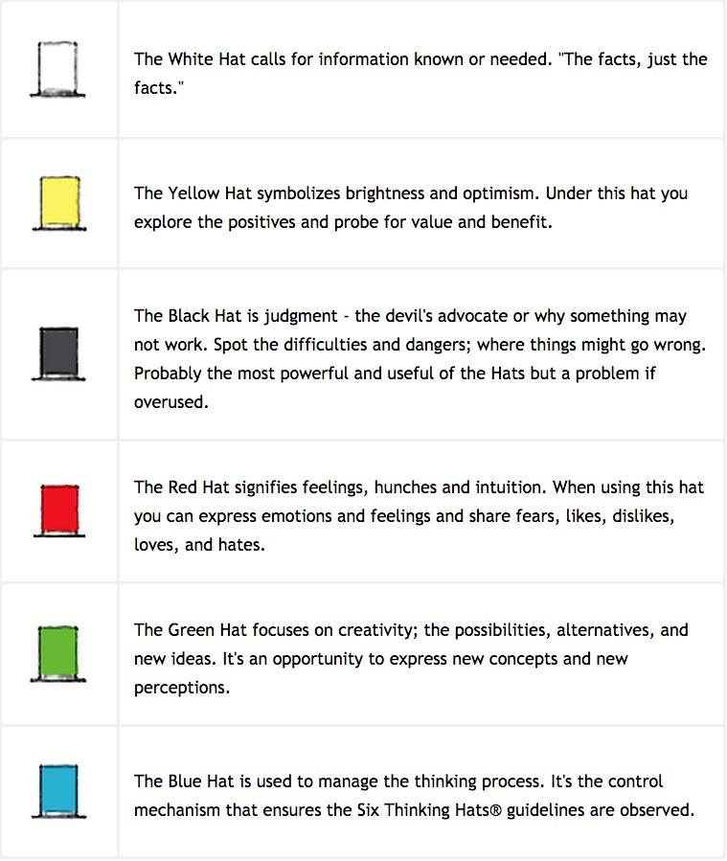
de Bono’s 6 hats
A framework for creative thinking.
Each hat is explored by an individual one at a time - you can’t wear a purple (blue + red) had.
You need to switch hats
Notes:
Which one do you tend more towards?

Slide 2
C-Sketch
Each person gets a paper
Divide the paper in three sections
Spend 5-10 minutes generating 3 good ideas
Record sketches [and words when necessary]
Switch papers. Build off ideas for 5 minutes
Repeat until everyone has worked on every sheet
Process and discuss.
You can put on different hats to move the discussion along.

Slide 3
crazy ideas (=≠) great solutions
Notes:
A lot of times we’re told to brainstorm crazy ideas. But crazy ideas themselves will not yield great solutions. They must be moved out of their latent state of uselessness. At the same time, difficult problems are not often solved with obvious solutions. They require “out of the box” thinking. The process must both diverge and converge.
Lateral thinking recognizes the value in movement – moving out of the latent state of uselessness to usefulness by specific operations.

Slide 4
“Planes should fly upside down”
Initially sounds absurd – wings would give negative lift!
Movement leads to the idea of retractable winglets that, when deployed, generate negative lift (positive lift when upside down)
This leads to the idea that these winglets would be normally deployed, but could be quickly retracted if a plane experienced a sudden loss of lift
Notes:
Note: could lead to other ideas too. For example, pilots would have a great view of the runway – what might that inspire?
We’ll look at ways to generate POs, then ways to stimulate movement

Slide 5
Provocation
Encourage statements that make no sense, might contradict known experience.
Use as a stepping stone to a new idea (de Bono calls movement)
The Provocative Operation is often referred to as a ‘PO’ . POssible, hyPOthesis, supPOse, and POetry
Provocation encourages you to unsettle your mind, unpack assumptions and propose radical ideas
Notes:
The problem we often have is incremental thinking – generating conservative things
We need to get more radical!
Technology all to often evolves under old assumptions
Provocation is designed to unpack these assumptions and then move forward without them
We can bring back in constraints as needed (after the brainstorming phase).

Slide 6
Task:
Method of Generating Movement
PO
Extract
Difference
Moment
Positive
Circumstance
Escape
Reversal
Method of generating PO
Distortion
Exaggeration
Wishful
Notes:
Pass out worksheet here
Have them fill in their problem at the top of the sheet under tasks

Slide 7
Generating Provocations - Provocative Operations (PO)
Escape
Reversal
Distortion
Exaggeration
Wishful Thinking
Notes:
Anything can be treated as a provocation – but these are the 5 formal methods de Bono describes. Sometimes they simply arise.
Let’s look at each of these.

Slide 8
Provocative Operation
escape
Step 1: Describe something that you take for granted
Step 2: Escape from that which you take for granted
Watchdogs bark
PO: Watchdogs that do not bark
Movement: watchdog trained to press button triggering alarm and alerting authorities
Restaurants have seats
PO: Restaurants with no seats
Movement: restaurant that charges for food and time spent

Slide 9
Provocative Operation
reversal
Step 1: Articulate the relationship between components/systems.
Step 2: Modify cause-effect relationship, semantic relationship, flip roles
Filters in cigarettes are there to remove tar
PO: We add something instead of removing it
Movement: Add air to dilute the harmful effects of the smoke
I have orange juice for breakfast
PO: The orange juice has me for breakfast
Movement: I swim in orange juice, scented shower water
The phone rings when I get a call
PO: The phone rings constantly until I get a call
Movement: indicator on phone showing it is live

Slide 10
Provocative Operation
distortion
Step 1: Articulate the normal sequence of events.
Step 2: Change the order in the sequence of events.
You pick up the phone before dialing
PO: You speak before you dial
Movement: voice activated dialing (exists) or record a complaint or order then have it replayed without having to say it
You live before you die
PO: You die before you die
Movement: living benefits for life insurance policies

Slide 11
Provocative Operation
exagerration
Step 1: Consider something that involves measures, dimensions.
Step 2: Exaggerate any one aspect (or dimension) of an initial statement making it somewhat unreasonable. Avoid exaggerating to zero (or it becomes an escape)
PO: Telephone calls can only last two minutes
Movement: compression capability so that you can talk at normal speed but utilize less equivalent line time
PO: Police have six eyes
PO: Telephones are too heavy to lift

Slide 12
Provocative Operation
wishful thinking
Express a wishful desire which is impossible to realize
PO: All telephone calls are friendly
Movement: green light on phone lights up when someone on friends list calls
PO: You got paid for waiting to see the doctor (who is behind schedule)
PO: The pencil writes by itself
Notes:
Should be more than just a desire

Slide 13
Final thoughts on POs
The more provocative the better
Provocations should not be solution ideas or concepts (yet)
avoid ideas ‘fitting in’
Once we have a PO, it’s time to look for movement!

Slide 14
Movement
Extract a Principle
Focus on the Difference
Moment to Moment
Positive Aspects
Circumstances
Notes:
(Generating Ideas from a PO)
Let’s look at each of these!

Slide 15
Results from provocation
Negative points may arise – but do not focus on them; instead attempt to look forward
Old ideas resurface – there’s no point in using provocation to generate old ideas; again strive to move forward to new ideas
A feeling of ‘something interesting’ is often a sign of potential
Points of difference from the status quo may be worth exploring
When value is found, always look for other ways you might achieve the same value
Notes:
Example of negative point: car with engine on roof has high cg

Slide 16
Results from provocation
Many concepts normally result – and they should be explored for practicality, combinatorial options, and strengthened where possible
All resulting ideas should be documented for the record
Sometimes a useful concept results
Other times provocation yields nothing seemingly practical – in that case harvest what you can learn from the failure – and hope for better results next time!
Notes:
Example of negative point: car with engine on roof has high cg

Slide 17
Movement
extract a principle
Seek to extract a principle, concept, feature, or aspect of the PO (meaningful characteristics), then ignore the rest of the PO and work only with what you’ve extracted to generate ideas
Example: An ad agency was seeking a new medium -> PO: bring back the town crier -> Extract:
The town crier can change the message based on audience
The town crier can go where the people are
The town crier can answer questions
The town crier is always up to date
You cannot switch the town crier off -> Movement: pay phones are free but calls are interspersed with ads

Slide 18
Provocative Operation
focus on the difference
Compare the provocation with the existing situation, identify the key differences, and pursue them
Example PO: postage stamps should be long and thin -> Difference: length to width aspect ratio -> Movements: Length of stamp meters its value

Slide 19
Provocative Operation
moment to moment
Visualize the PO being put into effect moment to moment and seek to develop interesting new ideas. “What would would happen if you actually did it?”
Examples:
PO: a car should have square wheels - > Moment to Moment: the axle rises and falls as the corners rotate around -> Movement: active suspension adjusts its height to give a good ride knowing when the corners are coming -> active suspension knows when bump is coming and adjusts accordingly
PO: Plane lands upside down -> Moment to Moment: pilot can see runway well while landing -> Movement: Concorde drops nose during landing for better visibility

Slide 20
Provocative Operation
positive aspects
Look directly for any benefits or positive aspects of the PO, take those benefits/aspects and try to move forward
Example: PO: A car should have its engine on its roof -> Positive Aspects: ease of access for maintenance, shorter car, better airflow for cooling, less risk of engine damage in a collision, equal weight distribution -> Movement: a short, mid-engine car with the occupants seated above the engine

Slide 21
Provocative Operation
circumstances
Identify the circumstances under which the PO would have a direct value
Examples:
PO: A car should have its engine on its roof -> Circumstances: in a flood the engine could still operate -> Movement: elevated intake to prevent water ingestion
PO: drinking glasses should have rounded bottoms -> Circumstances: Bars would sell more drinks, or no furniture rings since glass must be placed on special coaster
Notes:
Note – there is overlap in the 5 techniques (positive of no rings, moment to moment of bar patron holding glass whole time, etc.)
Now let’s look at possible results from provocation.

Slide 22
Methods for generating POs
Escape: Pick something we take for granted and drop that
Reversal: Take a normal relationship and reverse it
Distortion: Make a change to the normal sequence or relationship
Exaggeration: Exaggerate an aspect of a statement
Wishful thinking: Wouldn’t it be nice if “…”
Extract a principle: Extract a principle, concept, feature, or aspect of the PO, then ignore the rest of the PO and work only with what you’ve extracted to generate ideas
Focus on the Difference: Compare the provocation with the existing situation, identify the key differences, and pursue them
Moment to Moment: Visualize the PO in effect moment to moment
Positive Aspects: Look directly for any benefits or positive aspects
Circumstances: Identify the circumstances under which the PO would have a direct value
Methods for generating movement

